Slide 1
MapReduce
There’s a big data problem…

Slide 2
Lesson Objectives
What is Big Data and Cloud?
An effective strategy to process data on a large scale
Local wordcount example using MapReduce
Pseudo-distributed single cluster wordcount implementation using Python on Hadoop
Pseudo-distributed single cluster

Slide 3

Big Data
Yes, it’s a bit of a buzz word, but:
Amount of data is growing at a RAPID rate
In a variety of different formats
How can we perform analysis on the data when it’s so big that companies use multiple data warehouses to store it?
Big data has always been there, but has ‘recently’ been enabled by:
Cloud Computing
Distributed Computation Frameworks
Source

Slide 4
Why did Big Data become prevalent?
Both big data and data science have always been relevant
Although their value is shining more now than ever before
Because we have technological advancements enabling us to collect, analyse and present data in better ways.
Collecting data: Easy to access users (web surveys, social network graph dynamics, IoT devices etc)
Analysing data: Advancements in big data tools (Elastic computing, distributed data frameworks)
Presenting data: Advancements in web technologies and data science leading to interactive plots and reports

Slide 5
About Cloud
I’m sure you have some implicit understand as to what cloud computing is
“Cloud computing is a model for enabling ubiquitous, convenient, on-demand network access to a shared pool of configurable computing resources (e.g., networks, servers, storage, applications, and services) that can be rapidly provisioned and released with minimal management effort or service provider interaction.”
Mell and Grance. “The NIST Definition of Cloud Computing”. NIST Special Publication 800-14. September 2011. National Institute of Standards and Technology, U.S. Department of Commerce.

Slide 6
Taxonomy of Cloud Applications
Cloud applications popularised an “as a service” model. Some examples are SaaS (Software), PaaS (Platform), IaaS (Infrastructure)
Others exist - generally acronymised as XaaS
Aforementioned three are most popular
Software as a Service (SaaS)
“Out of the box” software which requires no maintenance from us
Platform as a Service (PaaS)
Provides a runtime environment for developers to build applications (e.g. no need for developers to manage and provision servers)
Infrastructure as a Service (IaaS)
Provides barebone resources (CPU, RAM, disk) as resources
SalesForce, Google Apps, Office 365, Slack etc
Google AppEngine, Heroku, Azure, AWS Elastic Beanstalk, Hadoop ;)
Amazon EC2, Google ComputeEngine, AWS
Many more exist: Not a comprehensive list of examples
Notes:
Paas: (think of it as hiring a venue to put on a show vs building a venue. The venue stays the same across different shows, but what is created in the space is unique)

Slide 7
Uhhh… So what??
Less reliance on stand alone applications
Impossible applications now possible (scale)
Resources on demand (budget not a key obstacle anymore)
Abstracts complexity away from users
Security (via distributed backups)
Allows us to create value from data. (Sitting on data creates no value)

Slide 8
MapReduce
MapReduce is a master/slave programming model which simplifies the distribution of large processing jobs (e.g. terabytes/petabytes)
Designed with the understanding that: hardware fails, networks are slow, and machines are different.
MR concept introduced in 2004 by Google
Reverse engineered by 2 devs who founded Apache Hadoop in 2006
Hadoop ecosystem has been expanding since then (HDFS, Hbase, Hive etc)
Despite Google not using it anymore, MR principles underpins most major big data frameworks

Slide 9
MapReduce
Processes parallelizable operations of large datasets across multiple worker nodes (computers).
A collection of nodes is usually referred to as a cluster.
Processing can occur on data stored in a filesystem or a database
Hadoop contains something known as DFS, which stands for: Distributed File System. Hadoop’s implementation of this is HDFS.
Intuitively, a DFS is when data stored on a server can be accessed and processed as if it was stored on a local client machine

Slide 10

MapReduce
MR has three key phases… you can probably guess two of them
Map is a function. Each worker/mapper node applies the map function on local data. Output data is written as <key,value> pairs to temporary storage.
Shuffle and sort: Based on the keys output by mappers, worker nodes sort and redistribute data such that data for a distinct key across all the data are now on one worker/reducer node
Reduce: Worker/reducer nodes process each group of data

Slide 11
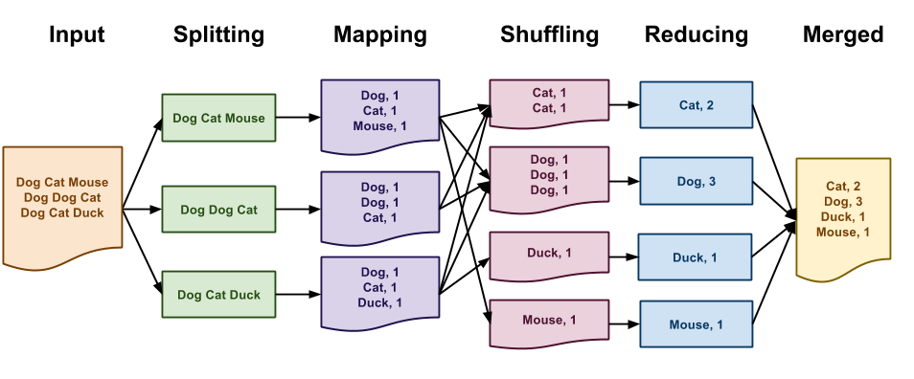
Source

Slide 12
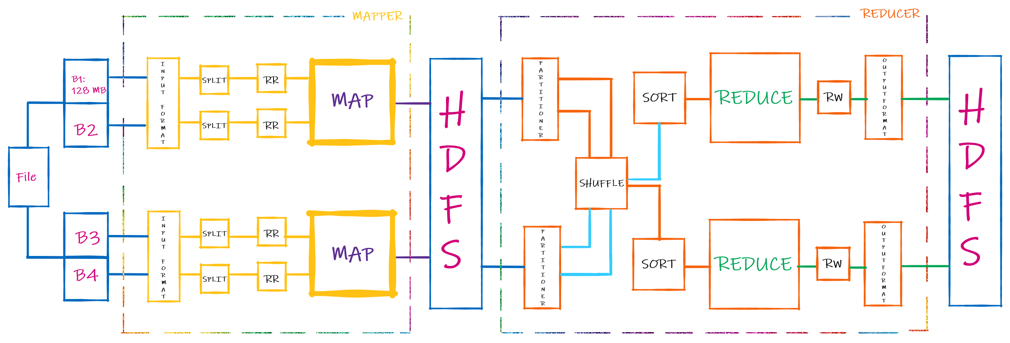
Source

Slide 13
MapReduce
Most MR implementations will follow these 5 steps:
Prepare the MR input. The MR system assigns mapper worker nodes, splits the file(s) into blocks and assigns a data block to each worker
Run the map function. Available workers map their input data to a set of <K,V> pairs in a parallelised fashion.
Shuffle map output to reducers. MR system receives map output and groups data by key. MR system then assigns reducer worker nodes, each of which assigned. This key will indicate with which map generated data that a given node will be operating with.
Run the reduce function. Reducers run the reduce function for data associated with the key provided.
Collate final output. MR system collects all reducer outputs, and then sorts and combines the data.

Slide 14
Implementations
We will be implementing the following three things:
A basic ‘in python’ word counter problem
A word counter in Hadoop

Slide 15
Basic word counter
We’re given some documents and want to count the frequency of each unique word across all documents
We won’t be mimicking the distributed nature of MR in this challenge
You will need to:
Join all the documents together
Define a map function. This map function will take a string as an argument, and output a list of tuples. Each tuple will be a (K,V) pair where K is a word, and V is 1
Sort and Shuffle! Sort the list on K, and then shuffle the list. In the shuffle step, I want a dictionary as output. The dictionary will contain {K, V[]} pairs. Again, K is a word, but V[] is a list of values. This list should be filled with as many 1s as there are instances of the K in the sorted list.
Define and run a reduce function. The reduce function will receive a dictionary of {K, V[]} pairs and reduce the output to (K, V), where K is the word/key, and V is the sum (count would also work in this case) of the V[] elements

Slide 16
Word counter in Hadoop
Underlying implementation for this is similar to what we just coded
Some differences though
We’ll be working with a pseudo-distributed single-node cluster using the Hadoop Streaming API
Allows us to use Hadoop without knowledge of Java
Hadoop itself will shuffle + sort for us
Data
MR System
StdIn
Mapper
StdOut
StdIn
Reducer
StdOut
Output
Mapper
Mapper
Mapper
<K, V[]>
Mapper

Slide 17
Word counter in Hadoop
We’re going to need two files: mapper.py and reducer.py
mapper.py will:
Read string data via StdIn
Split the string data into words and perform any transformations
Output each word and “1” directly to StdOut
reducer.py will:
Read the output of mapper.py from StdIn
Sum the occurrences of each word to a final value
Output results to StdOut
Let’s implement this!
Ignore shuffle/sorting for now

Slide 18
Command line time!
Before we test in Hadoop, let’s run the mapper and reducer as we’ve finished writing them.
If you’re on Windows, let’s use Ubuntu to work with this.
In file explorer, type \wsl$ as the path and you’ll open up the subsystem directory. You can copy your files into /home/[username]
To run mapper:
$ echo “This is a test input. this is a random input string” | python3 mapper.py
To run mapper and reducer:
$ echo “This is a test input. this is a random input string” | python3 mapper.py | sort -k1,1 | python3 reducer.py

Slide 19
Hadoop time!
Before we run the MR job, we need to copy our local Gutenberg files HDFS (actually this was done in the setup… but lets do it again 😈)
$ hdfs dfs -copyFromLocal ~/tmp/gutenberg /user/[username]/gutenberg
$ hdfs dfs -ls
$ hdfs dfs -ls /user/[username]/gutenberg
Let’s run Hadoop MapReduce!
$ mapred streaming \ -input /user/[username]/gutenberg \ -output /user/[username]/gutenberg-output \ -file mapper.py \ -mapper /home/[username]/mapper.py \ -reducer /home/[username]/reducer.py

Slide 20
Inspect output
Hadoop automatically sorts by the key for us.
We can explicitly specify a secondary sort key if we want control
Let’s check if our reduce task has created outputs successfully:
$ hdfs dfs -ls /user/hduser/gutenberg-output
And we can inspect the output:
$ hdfs dfs -cat /user/hduser/gutenberg-output/part-00000

